Slide 1
Uses of Technology Systems
Technology Systems

Slide 2

Introduction
A computer is a machine that processes digital data.
When we talk about a technology system, what we mean is the complete collection of components that make up a single computer installation.
Technology systems have become fundamental to the modern working world in every industry.
In this lesson, we’ll learn about:
Construction
Finance
Health
Manufacturing
Retail

Slide 3

Construction
Within the construction industry, technology systems are used both in the planning, design, and management of a development project and in the actual construction of the building or structure.
Examples of how it can be used to support this include:
Planning projects
Creating architectural drawings
Tracking spending
Let’s look at each of these in more detail.

Slide 4

Construction Examples
Planning Projects
Project management software can be used to schedule the development of a construction project, assign time to individual tasks, work out the order of tasks and assign resources.
This can help manage time effectively to avoid going over the deadlines in a construction project.
Creating Architectural Drawings
Technology systems can be used to develop architectural drawings and blueprints for the design of buildings/structures. CAD software produces the drawings, and plotters print out large-scale hard copies of the design.

Slide 5
Construction Examples
Tracking Spending
Accounting software can be used to manage money and track spending within a construction project to help ensure the project’s budget is kept. The automatic calculation of expenditures can also prevent mistakes due to human error.

Slide 6

Finance
The finance sector uses technology systems to help with investment, banking, and completing transactions. It has been important to make these things more accessible and reduce errors.
Examples of where it is used to support this include:
Stock monitoring
Interest rate calculation
Let’s look at each of these in more detail.

Slide 7

Finance Examples
Stock Monitoring
Stock market software allows professionals and individuals to monitor the stock market and their investment portfolios to see how well or poorly their investments are doing and to make decisions on when and where to move their finances.
Interest Rate Calculation
Personal and business loans and savings are affected by interest rates which can increase what you owe on your loan repayments or increase the savings in your account.
Technology systems can calculate how these interest rates will affect you.

Slide 8

Health
Your hospital, your GP & your pharmacy all use technology systems to support how they work and ensure the best medical care is given.
Examples of where it can be used to support healthcare include:
Scanning
Monitoring
Let’s look at each of these in more detail.

Slide 9

Health Examples
Scanning
X-ray, MRI, and CAT scanners are all examples of technology systems used in healthcare. These devices allow for the fast diagnosis of injuries and diseases without the need for surgery.
Monitoring
Temperature, blood pressure, and heart rate sensors monitor a patient’s health to ensure that their recovery progresses as expected and doesn’t deteriorate. These sensors allow for 24/7 monitoring and free staff to perform other duties.

Slide 10
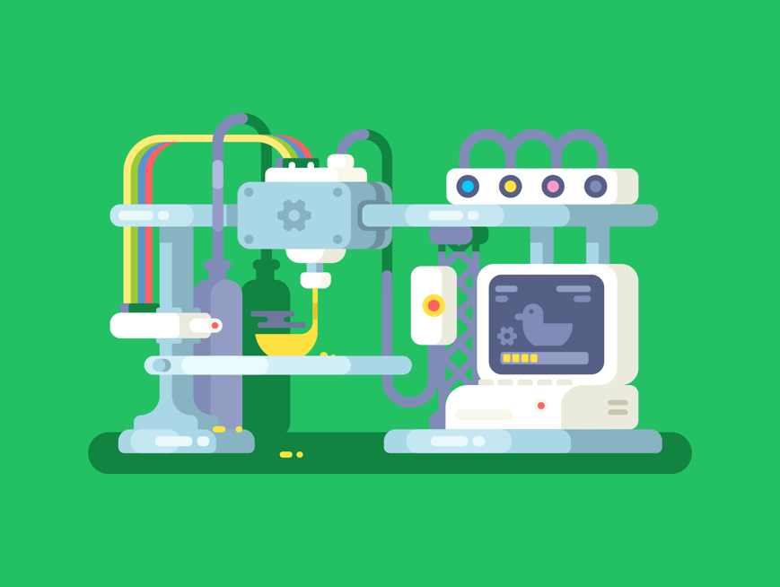
Manufacturing
The manufacturing industry has seen huge changes as a result of the development of technology systems.
The way we design parts for production and develop the final parts is heavily computerised.
Examples of where it can be used within manufacturing include:
Computer-Aided Design
Computer-Aided Manufacturing
Let’s look at each of these in more detail.

Slide 11

Manufacturing Examples
Computer-Aided Design
CAD systems are used to create technical drawings. This is used in the manufacturing industry to produce plans and other design drawings for parts and products that can be created using CAM.
This CAD software allows for the designs to be viewed in detail and rotated in 3D to view the part or product from all angles.
Computer-Aided Manufacturing
CAM systems control machinery, such as robots, to manufacture the objects we have designed using CAD.
This gives greater consistency to the quality of the manufacturing work as well as greater efficiency as the process of building the part is often quicker than with manual labour.

Slide 12

Retail
The retail sector is perhaps the most obvious industry where technology systems have had an impact.
It has not only made shopping on the high street quicker and easier but also given us different ways of shopping, such as online.
Examples of uses of technology systems within retail include:
Electronic Point of Sale
Online Shopping
Let’s look at each of these in more detail.

Slide 13

Retail Examples
Electronic Point of Sale
EPOS systems allow for quick and accurate checkout within shops through the use of barcode scanners, electronic payment methods (e.g. credit card), and automatic calculation of total bills.
This allows for faster transactions and less queuing time.
Online Shopping
Shopping is now commonly performed online. Companies such as Amazon don’t even have high-street stores and run solely online,
Online shopping allows customers to shop 24/7 and easily find the best prices by comparing different online stores. It is also an important means of advertising products.

Slide 14

Lesson Summary
A computer is a machine that processes digital data.
A technology system is a complete collection of components making up a single computer installation.
In construction, technology systems are used for planning projects, creating architectural drawings & tracking spending.
In finance, technology systems are used for stock market monitoring & interest rate calculations.
In healthcare, technology systems are used for body scanning & monitoring of heart rate, temperature, etc.
In manufacturing, technology systems are used for computer-aided design & computer-aided manufacturing.
In retail, technology systems are used for electronic point-of-sale systems and online shopping.

Slide 15
Copyright © 2024 KnowItAllNinja.com
This presentation and its associated worksheets are protected by copyright and are licenced for resale by KnowItAllNinja.com. No part of these publications may be reproduced, distributed, or transmitted in any form or by any means, including photocopying, recording, or other electronic or mechanical methods, without the prior written permission of KnowItAllNinja.com, except as per the terms of use.
Terms of Use
By purchasing and downloading these resources you are entering a licence agreement that allows for you to share these resources with members of a single educational institution. They must not be shared with or used by any third-party outside of the institution in any form.

