Slide 1
Size & Types of Enterprise
Exploring Enterprises

Slide 2
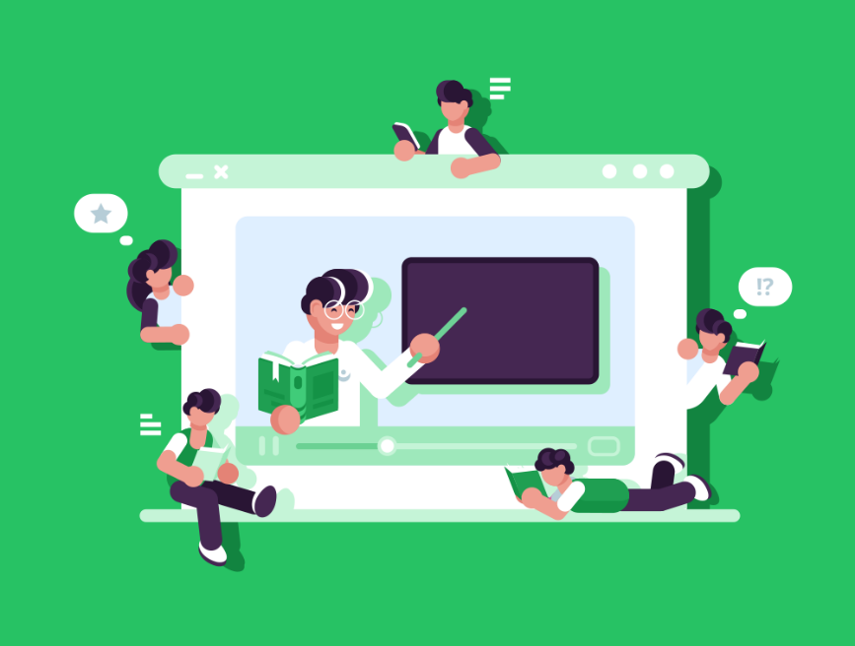
Introduction
The term “enterprise” is just another word for a business.
However, this term is more commonly used to describe where an individual has shown the initiative and taken on the risk of starting their own business.
Enterprises come in many different sizes and types, from the individual running a business on their own as a sole trader to large public limited companies with thousands of employees.
In this lesson, we’ll learn about:
The different sizes of SMEs
The types of profit-making enterprises

Slide 3
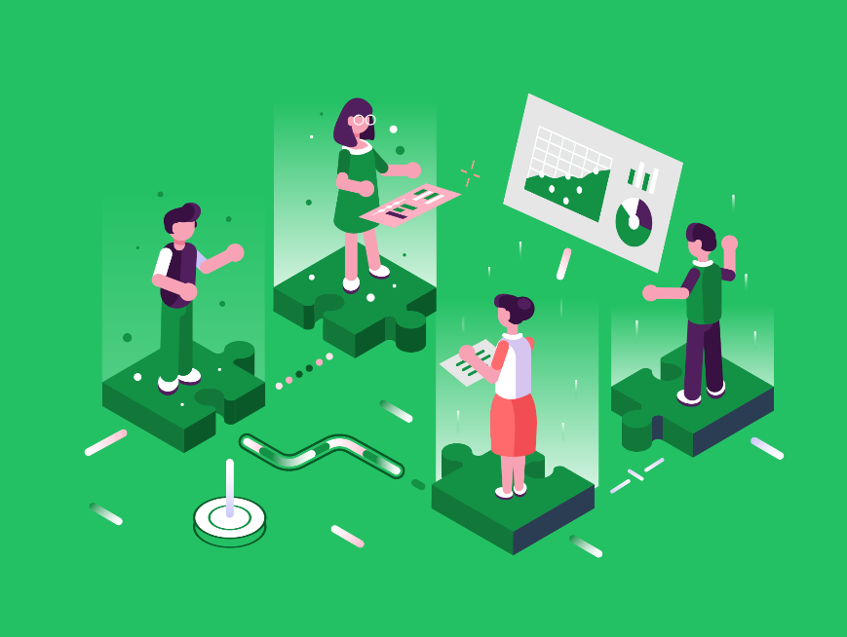
Size of SMEs
As mentioned in the lesson introduction, the term SME stands for Small and Medium-Size Enterprises.
However, we actually classify these into three different categories:
Micro
Small
Medium
Let’s look at each of these sizes of SMEs in more detail.

Slide 4
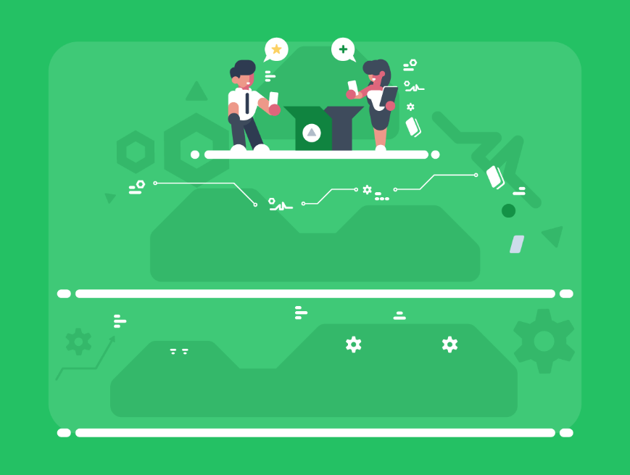
Micro
A micro-sized enterprise is a business that has up to 10 employees.
In 2020, there were 5.7 million micro-businesses in the UK, which makes up 96% of all businesses. These businesses also account for 33% of all UK employment and 21% of UK turnover.
Micro businesses are often operated as sole traders or partnerships, especially on the lower end of this size scale.
They also are often run by the owner on a day-to-day basis.
As well as being defined by their size, micro-businesses also have a turnover of less than £632,000 a year and less than £316,000 on their balance sheet.

Slide 5
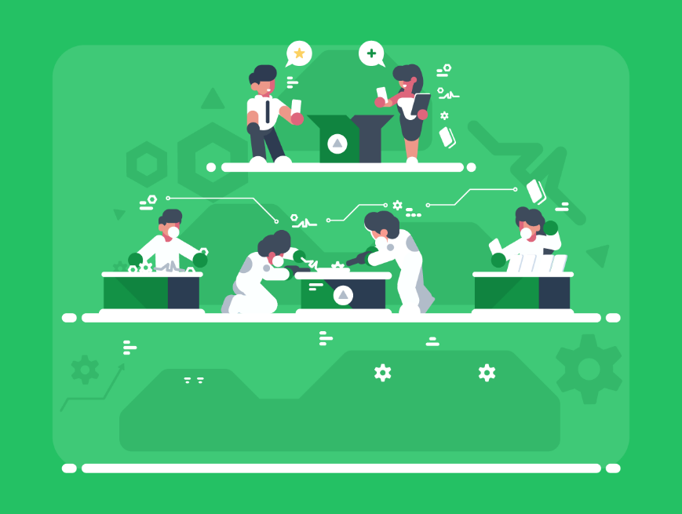
Small
A small-sized enterprise is a business that has between 10 and 49 employees.
These make up just 4% of all businesses in the UK, though they contribute 15% of all UK employment and 15% of all UK turnover.
Small-sized businesses are more likely to be operated as a limited company (we’ll learn more about what this means later).
Small businesses will have a turnover of £10.2 million or less and less than £5.1 million on their balance sheet.

Slide 6
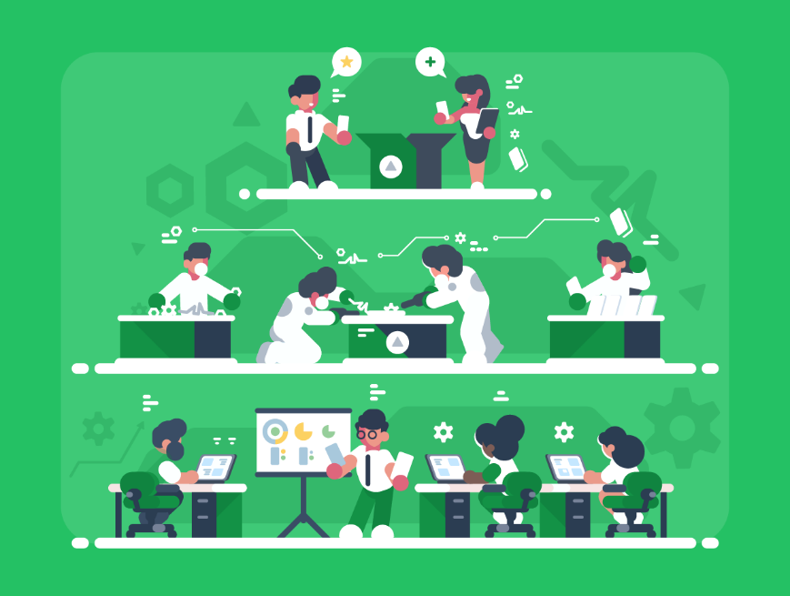
Medium
A medium-sized business is one that has between 50 and 249 employees.
This makes up just 1% of all UK businesses, though they do contribute to 13% of all UK employment and 16% of UK turnover.
Medium-sized businesses are typically well-established businesses. They will operate as a limited company.
A medium-sized business will have a turnover of less than
£36 million and a balance sheet of less than £18 million.

Slide 7
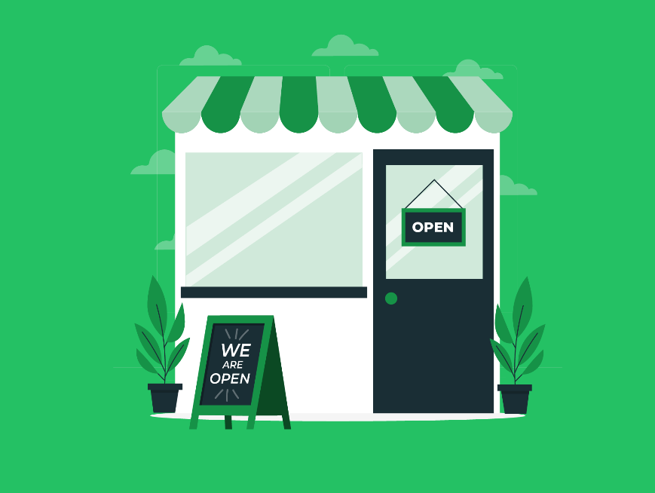
Types of Profit-Making Enterprises
Not all enterprises are profit-making. Some businesses are
not-for-profit, such as charities.
However, of course, most businesses do aim to make a profit.
But these profit-making businesses can fall into a number
of different classifications.
Sole trader
Partnership
Limited
Limited Liability Partnership (LLP)
Social Enterprise
Let’s look at each of these types of profit-making enterprises
in more detail.

Slide 8
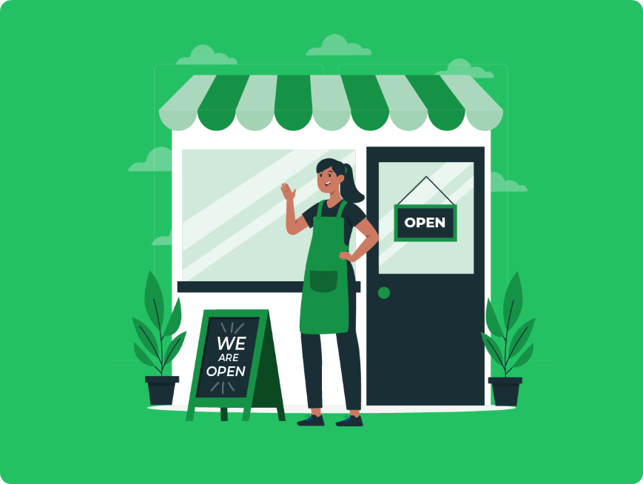
Sole Trader
A sole trader is a business run by a single self-employed individual (though they can still have employees).
The most significant feature of being a sole trader is that the business owner is not legally separate from the business. So, the owner is responsible for all of the business’s debts.
This means they might need to pay these debts out of their cash. This is known as having unlimited liability.
Despite this significant disadvantage, there are some benefits to being a sole trader.
You get to keep all the business profits (after tax) and have full control over how the business is run.
Setting up is also much simpler, as you don’t need to register anywhere. There is less paperwork involved, and tax is far simpler.

Slide 9
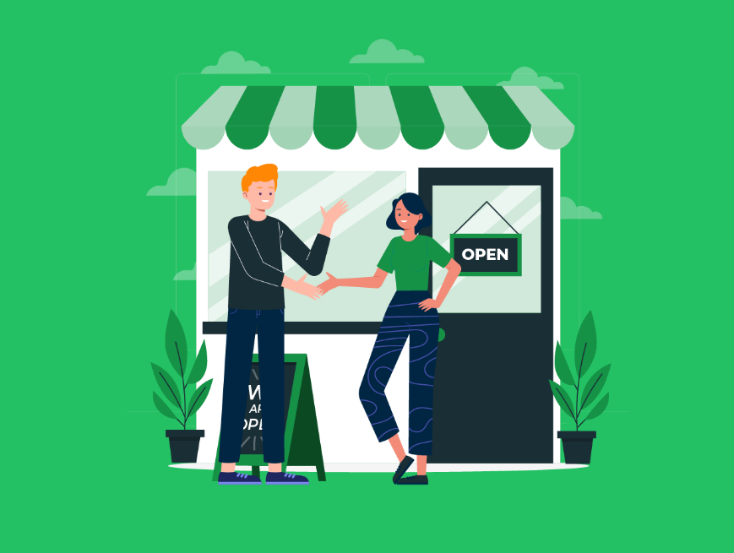
Partnership
A partnership is where the business is owned and operated by two or more people, and profits are split between these owners.
Much like a sole trader, the owners of a partnership have unlimited liability over the business’s debts.
An advantage of a partnership over a sole trader is that there is shared responsibility for the company’s debts. They don’t just fall on one single person.
Having multiple owners can also help raise funds when starting a business.
Like sole traders, it’s also simple to set up, has less paperwork, and has simpler tax.

Slide 10
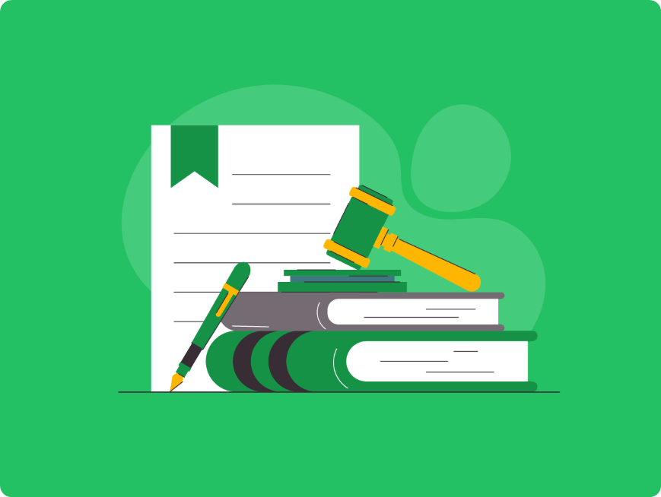
Limited
A limited company is where we incorporate a business so that it is its own entity in the eyes of the law.
This means there is a legal distinction between the business and the owners, and as such, the business owners are not responsible for the business’s debts. This is known as limited liability.
The company's ownership is split up into shares, which give each shareholder a percentage of the business.
These shareholders may not have any role in the running of the company, but they do get to elect a board of directors who will run the business.
Being a limited company can also be more tax-efficient once you’re earning a certain level of income.
However, there is a lot more paperwork involved in setting up and running the company and tax is more complicated to handle.

Slide 11
Types of Limited Company
There are actually two types of limited companies.
Public Limited Companies
The company is listed on the stock exchange, and anyone can purchase shares in the business.
Private Limited Companies
The company is not publicly listed, and the shares are held privately by members.

Slide 12
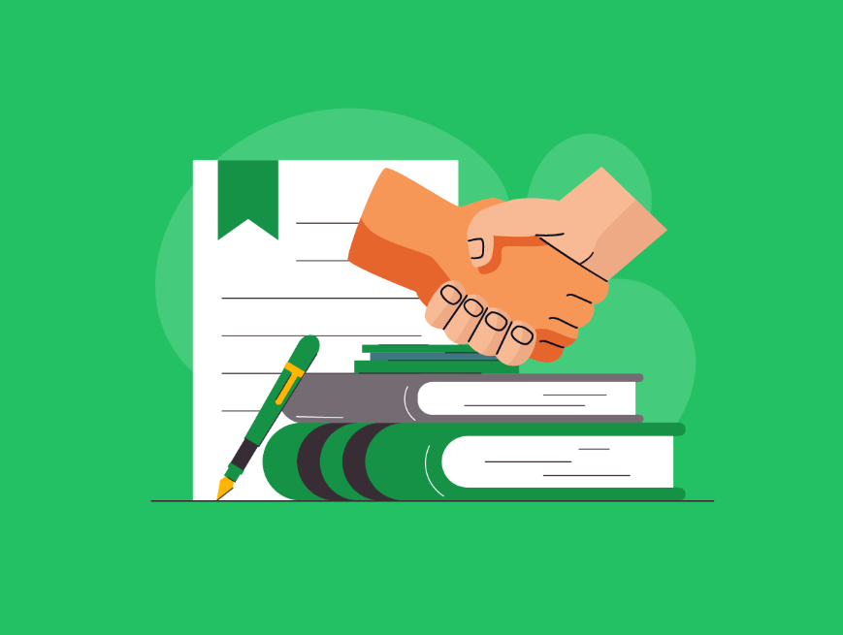
Limited Liability Partnership (LLP)
An LLP is like a cross between a partnership and a limited company.
Much like a limited company, LLPs must be incorporated with Companies House which gives the partnership limited liability.
However, profits are divided equally between partners and tax is handled by each partner individually. This means that, unlike a limited company, an LLP does not pay corporation tax.
So, an LLP has the limited liability of a limited company but the simplified tax of a partnership.
However, it is still complex to set up as you need to register with Companies House, and you don’t have the tax benefits that can come from being a limited business.

Slide 13
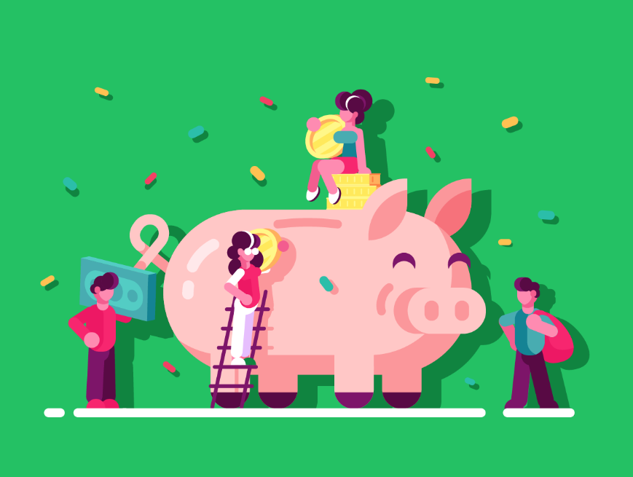
Social Enterprise
A social enterprise is a business that prioritises social goals over shareholder profits.
However, in many cases, a social enterprise will still generate profits which it will re-invest in the enterprise to help it grow and better achieve its social goals.
The Big Issue is an example of a social enterprise.
Social enterprises will still have one of the previous legal business structures, or alternatively may be registered as a charity or co-operative.

Slide 14
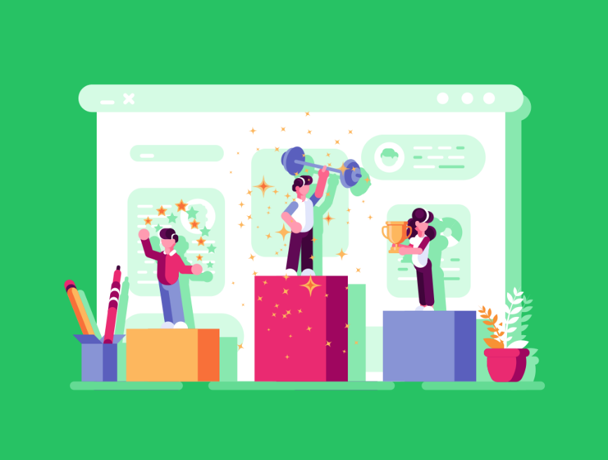
Lesson Summary
SME stands for Small and Medium-Sized Enterprises.
Micro-enterprises have up to 10 employees.
Small enterprises have 10 to 49 employees.
Medium-sized enterprises have 50 to 249 employees.
Sole traders are businesses run by a single self-employed individual.
Partnerships are owned & operated by two or more people.
Sole traders and partnerships have unlimited liability.
Limited companies are incorporated businesses recognised as separate legal entities.
LLPs are a mix of partnerships and limited companies.
Social enterprises prioritise social goals over shareholder profits.

Slide 15
Copyright © 2024 KnowItAllNinja.com
This presentation and its associated worksheets are protected by copyright and are licenced for resale by KnowItAllNinja.com. No part of these publications may be reproduced, distributed, or transmitted in any form or by any means, including photocopying, recording, or other electronic or mechanical methods, without the prior written permission of KnowItAllNinja.com, except as per the terms of use.
Terms of Use
By purchasing and downloading these resources you are entering a licence agreement that allows for you to share these resources with members of a single educational institution. They must not be shared with or used by any third-party outside of the institution in any form.

