Slide 1
Data & Information
Collecting, Presenting & Interpreting Data

Slide 2

Introduction
The terms “data” and “information” are often used interchangeably. However, these are actually two different, though related, things.
Understanding the differences between data and information is an important first step when wanting to create a dashboard to present information.
To understand the differences, we need to know the characteristics of data and information and how data becomes information.
In this lesson, we’ll learn about:
The characteristics of data
The characteristics of information

Slide 3
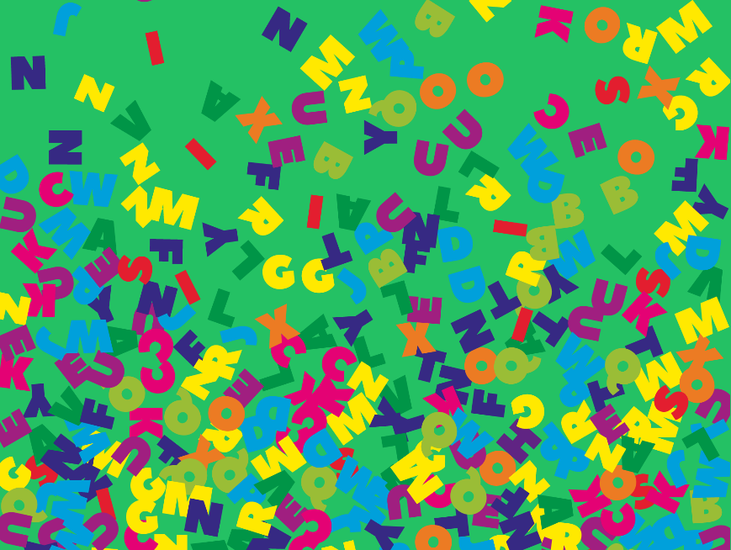
Data
Data are raw facts and figures. This could be numbers, dates, words, symbols, images, or sounds.
The key thing about data is that it:
Has no meaning
Has no structure
Has no context
Is unprocessed
What does this mean in practice though?

Slide 4
Data
Let’s look at some numbers.
11.3
10.1
10.6
11.0
What do these numbers tell you? What are they about? You don’t know!
This is because you have no idea what these numbers represent.
Are they times in a race? The speed of a car? The height of a room?
This is what data is. Raw facts and figures without any meaning, structure or context, that has not been processed.

Slide 5
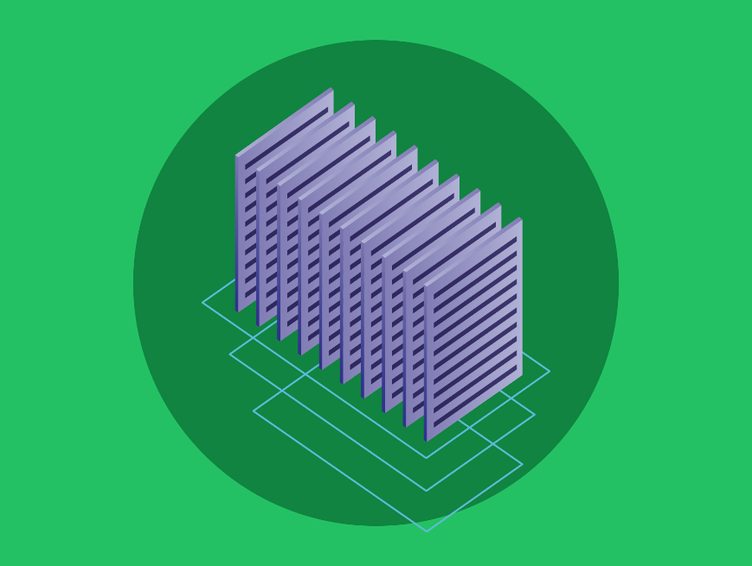
Information
Information is data that has been processed.
More specifically, information is data that:
Has meaning
Has structure
Has context
Is processed
What does this mean in practice?

Slide 6
Information
Let’s look back at the data from the previous section.
11.3
10.1
10.6
11.0
We didn’t know what these numbers were about. However, what if I told you that these are times in a race? Is this new information?
Not really. We have context but lack structure and meaning.
For example, are these times measured in seconds or minutes? Also, who does each time belong to?
Without knowing this, you wouldn’t be able to award the winner a gold medal.

Slide 7
Information
Let’s add further context to this data by saying that they are times from a 100m race measured in seconds.
We can process and structure this data by sorting it by time and structuring it into a table with the racers' names next to their times.
You see, this is now information.
We can now use this information for things like making decisions, such as who to award the gold medal to.
Runner | Time
Runner 2 | 10.1s
Runner 3 | 10.6s
Runner 4 | 11.0s
Runner 1 | 11.3s

Slide 8

Lesson Summary
Data are raw facts and figures.
This could be numbers, dates, words, symbols, images, or sounds.
Data has no meaning, no structure, no context and is unprocessed.
Information is data that has been processed.
Information has meaning, structure, and context and is processed.

Slide 9
Copyright © 2024 KnowItAllNinja.com
This presentation and its associated worksheets are protected by copyright and are licenced for resale by KnowItAllNinja.com. No part of these publications may be reproduced, distributed, or transmitted in any form or by any means, including photocopying, recording, or other electronic or mechanical methods, without the prior written permission of KnowItAllNinja.com, except as per the terms of use.
Terms of Use
By purchasing and downloading these resources you are entering a licence agreement that allows for you to share these resources with members of a single educational institution. They must not be shared with or used by any third-party outside of the institution in any form.

